Slide 1
Managing Student IDcodes

Slide 2
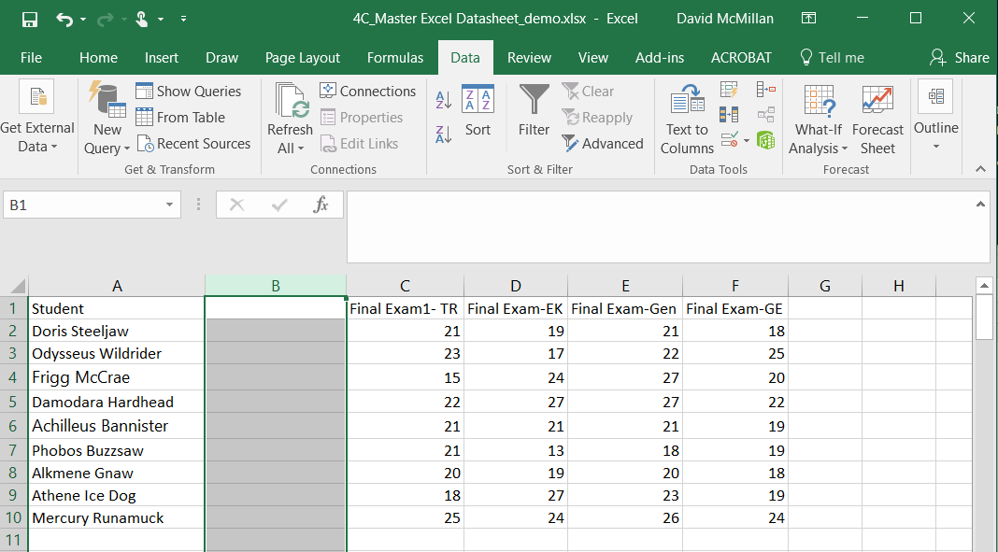
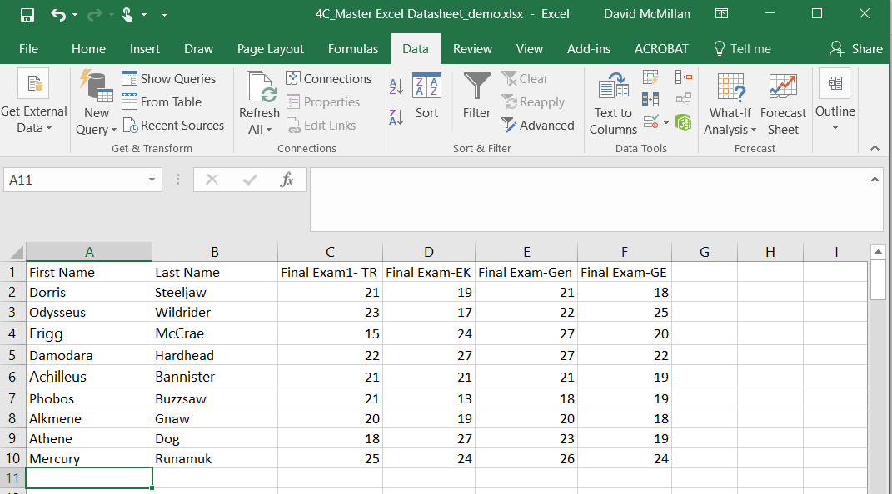
Converting single column student name to First name column and last name column:
1) Create a blank column to the right of student name column
2) Highlight column and select “Text to Columns” tool (Data Tab).
3) Options to choose: a) Delimited, b) space,
-Delimited (space

Slide 3
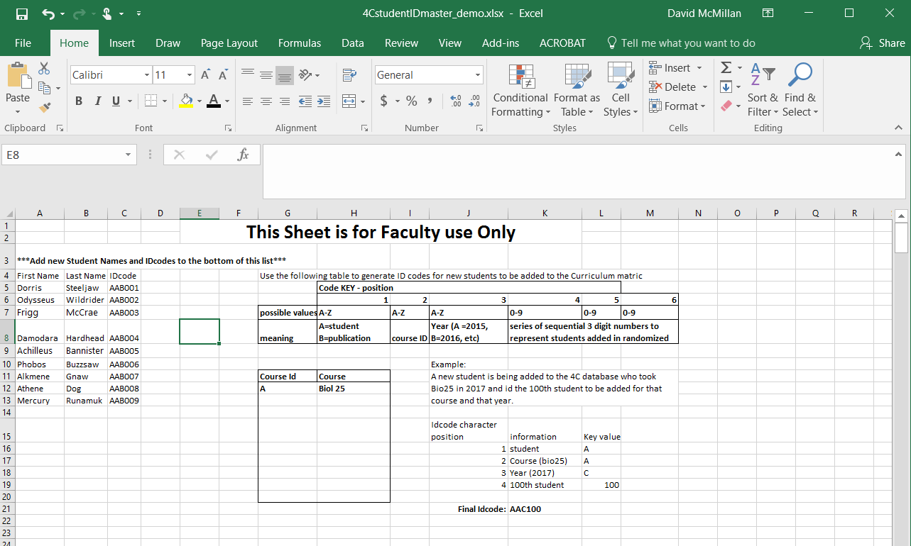
1- Copy names ---→ 2) Generate ID Codes
**Add new names and code to bottom of list

Slide 4
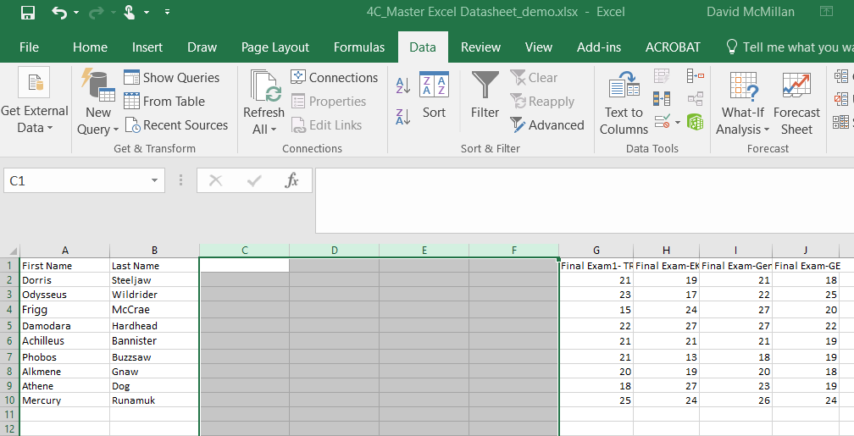
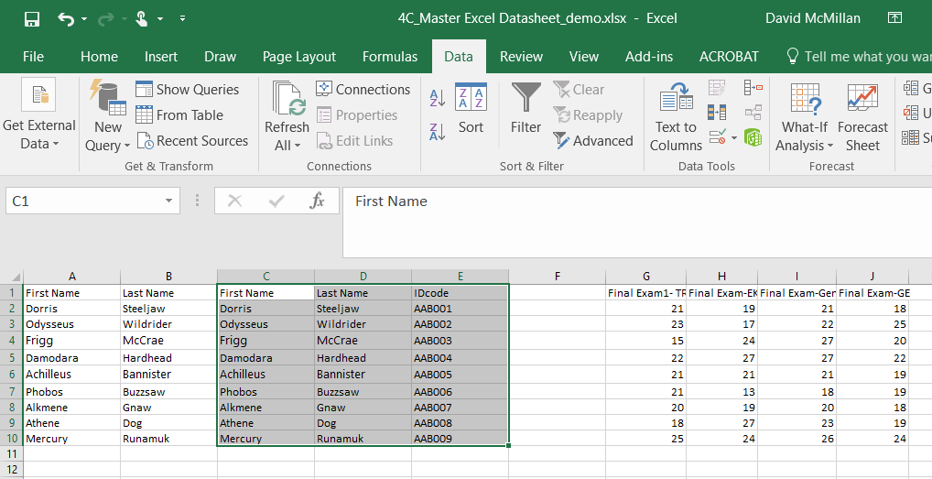
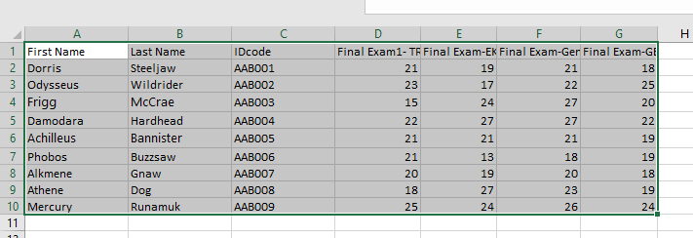
Insert 4-5 blank columns to the right of student name colums
Copy Student names and ID Codes from ID Code master sheet
Visually Inspect that names copied from ID Code Master sheet match original order of names
Delete copied names and blank columns --- Finished

